Slide 1

NEXTHIIKES IT SOLUTIONS
FINAL REPORT
RICHA SINGH

Slide 2
content
MERGING DATA SETS
CLEANING AND CONDITIONAL FORMATTING
PIVOT TABLE AND PIVOT CHART
DASHBOARD
SUMMARY

Slide 3
Merging datasets
To merge dataset_1.xlsx and dataset_2.xlsx , I was combined them based on common key like ( instant, date, temp, hum, atemp, windspeed, casual, Registered, count and week)
Step 1: Merge dataset_1 and dataset_2
Use the instant column as the key.
In dataset_1, use VLOOKUP or XLOOKUP to bring in atemp, hum, windspeed, casual, registered, and cnt from dataset_2.
Step 2: Merge the result with dataset_3
Again, use the instant column as the key.
Use VLOOKUP or XLOOKUP to bring in any new or updated columns from dataset_3. Since dataset_3 appears to be a continuation (starting from instant = 620), you can:
Append the new rows from dataset_3 to the bottom of the merged sheet from Step 1.
Ensure column headers match exactly.
Use Excel’s “Remove Duplicates” feature on instant if needed.

Slide 4
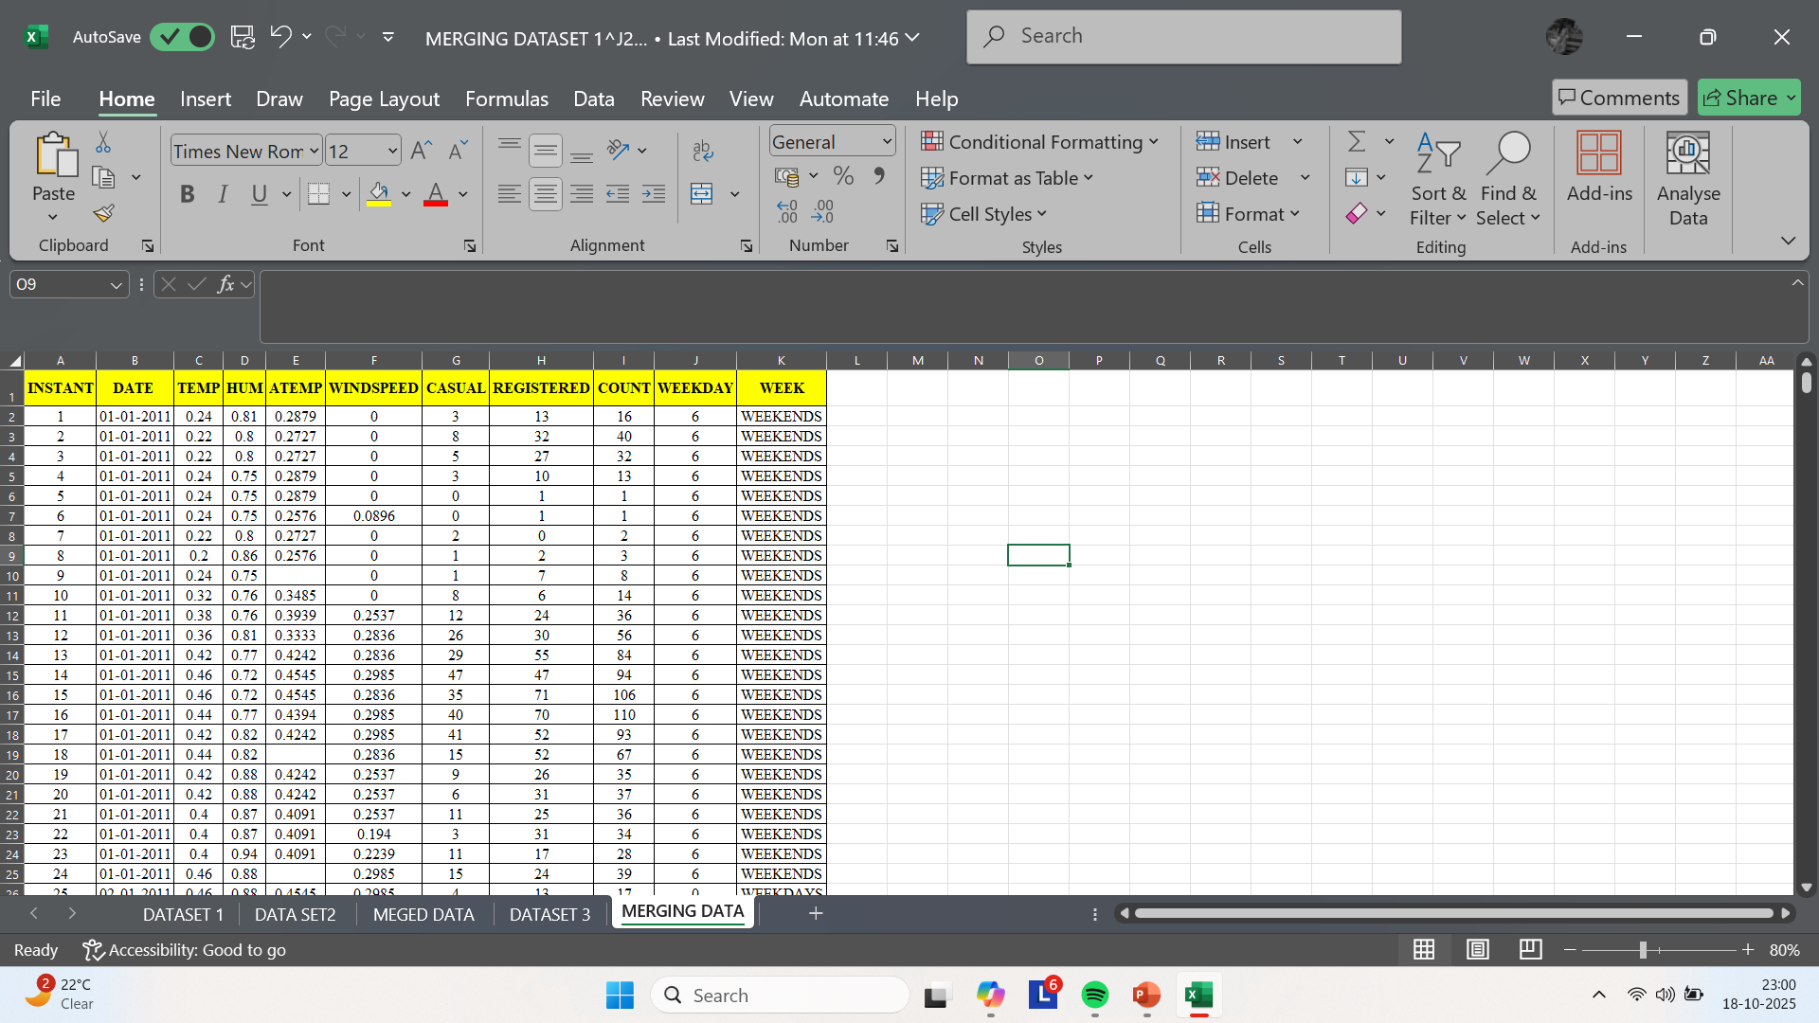

Slide 5
Cleaning and conditional formatting
Select the column or range.
Go to Home > Conditional Formatting.
Choose:
Color Scales for gradients.
Icon Sets for visual markers.
New Rule for custom logic (e.g., formulas).
Adjust formatting style (font, fill, borders) to match your dashboard theme.

Slide 6
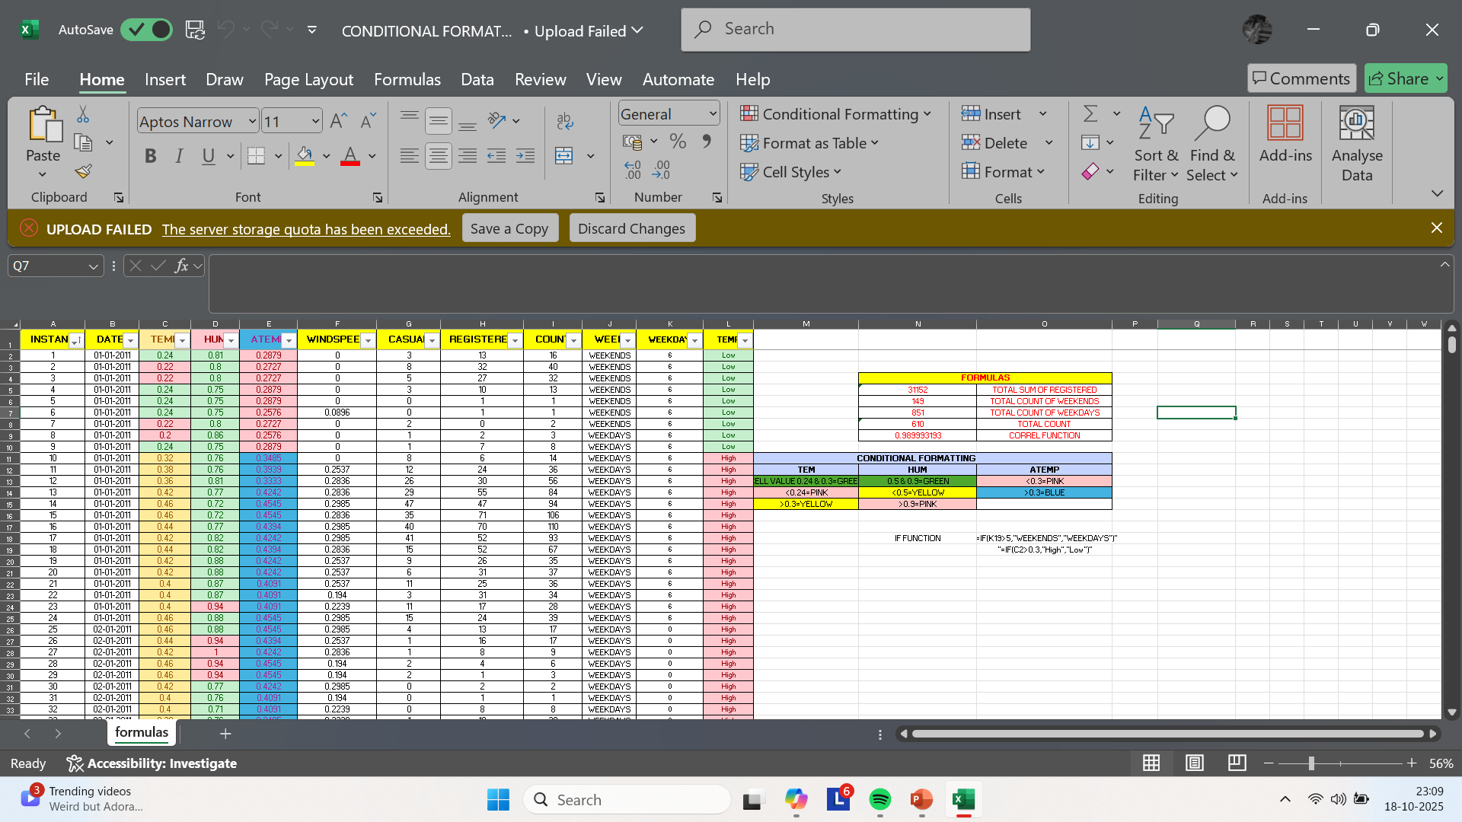

Slide 7
cleaning
Remove Duplicates
1
Find missing values by using Filter

Slide 8

Pivot table and pivot chart
Select Your Data
Click anywhere inside your dataset (e.g., including columns like DATE, CASUAL, REGISTERED, WEEKDAY, etc.).
Make sure your data has headers.
Insert a Pivot Table
Go to the Insert tab on the Ribbon.
Click PivotTable.
In the dialog box:
Ensure the correct data range is selected.
Choose whether to place the pivot table in a New Worksheet or Existing Worksheet.
Click Ok.

Slide 9

Add Fields to the Pivot Table
In the PivotTable Fields pane:
Drag WEEKDAY to Rows.
Drag CASUAL and REGISTERED to Values (they’ll default to SUM).
You can also add DATE to Columns if you want a time-based breakdown.
Insert the Pivot Chart
Click anywhere inside the Pivot Table.
Go to the PivotTable Analyze tab (or just Analyze in older versions).
Click PivotChart.
Choose a chart type (e.g., Clustered Column, Line, or Stacked Area).
Click Ok.
Customize your chart.

Slide 10
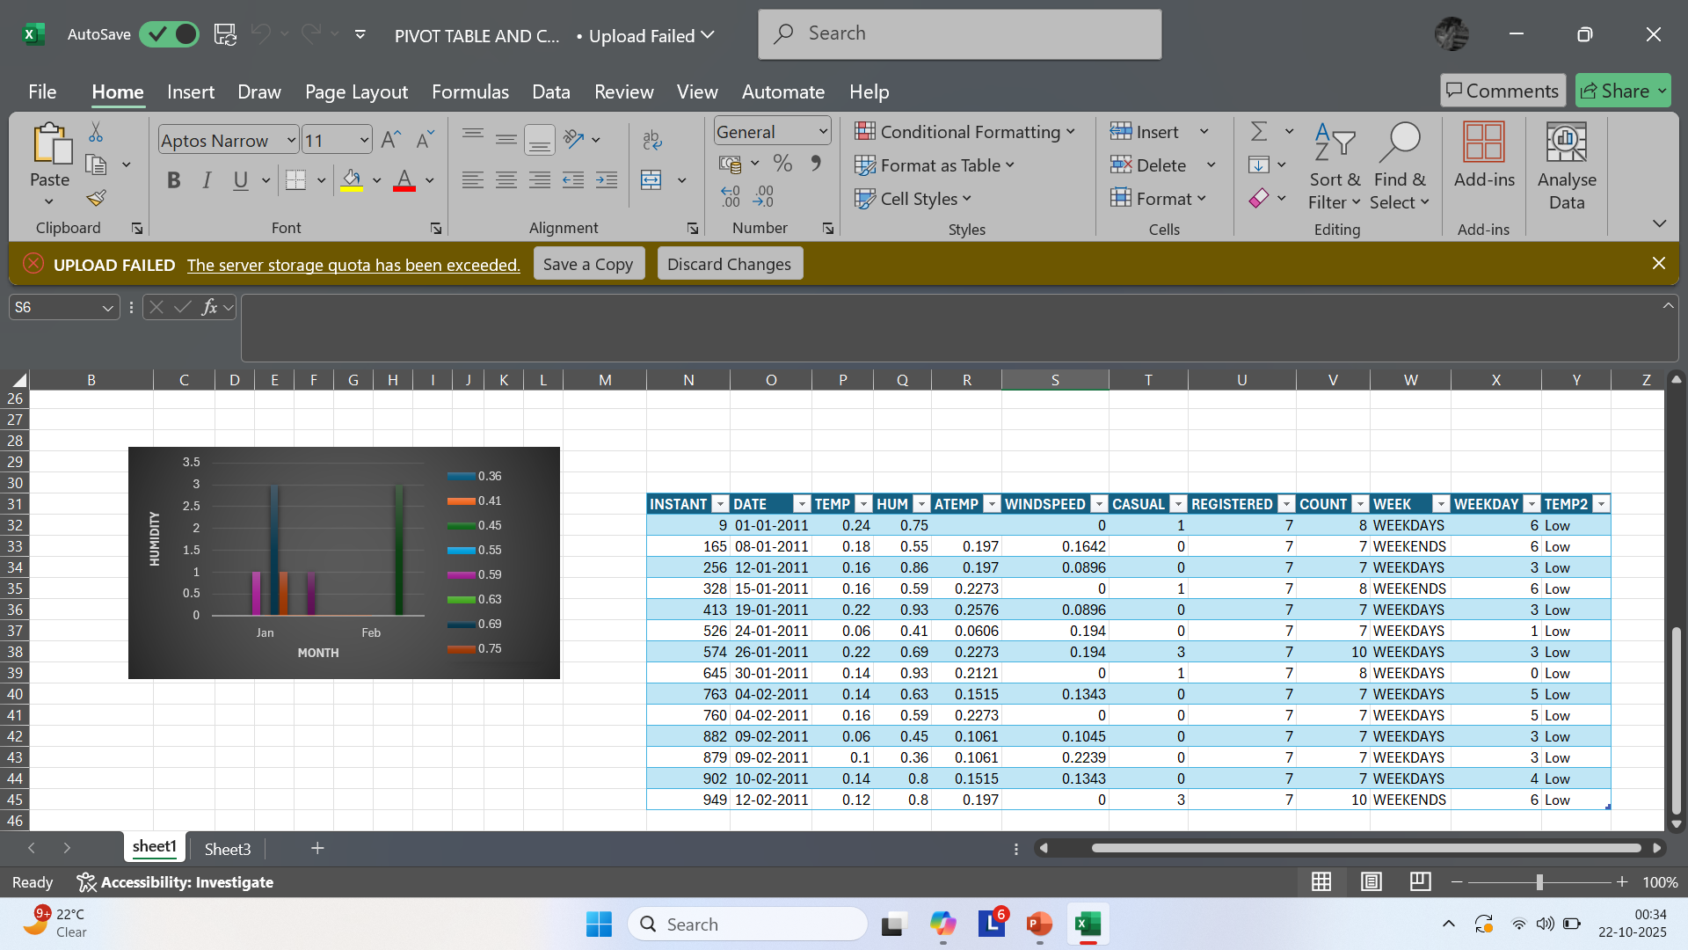

Slide 11
dashboard
Design the Dashboard Layout
Use a new worksheet titled “Dashboard”.
Arrange charts and tables neatly:
Group related visuals (e.g., temperature vs ridership)
Use shapes or text boxes to add titles and captions
. Add Slicers for Interactivity
Select a PivotTable.
Go to Insert > Slicer.
Choose fields like WEEKDAY, TEMP, or MONTH.
Slicers let viewers filter data dynamically.
Apply Visual Styling
Use soft, warm colors.
Add icons or images
Format fonts and borders for elegance and clarity.

Slide 12
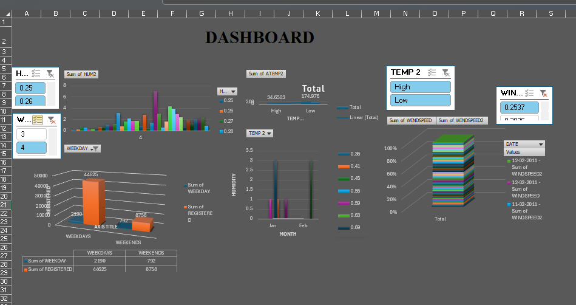

Slide 13
Summary
Merging Datasets
Combined dataset_1, dataset_2, and dataset_3 using the instant column as the key.
Used Excel functions like VLOOKUP/XLOOKUP to bring in relevant columns.
Ensured consistency and removed duplicates.
Cleaning & Conditional Formatting
Applied Excel’s built-in tools to highlight data patterns.
Used color scales, icon sets, and custom rules for visual clarity.
Removed duplicates and filtered missing values.
Pivot Tables & Charts
Created pivot tables using fields like WEEKDAY, CASUAL, REGISTERED, and DATE.
Visualized data with pivot charts (e.g., clustered column, line).
Enabled dynamic analysis of ridership trends
.

Slide 14
SUMMARY
Dashboard Design
Built an interactive dashboard with slicers for filtering by WEEKDAY, TEMP, or MONTH.
Grouped visuals meaningfully (e.g., temperature vs. ridership).
Applied warm colors, icons, and elegant formatting for emotional resonance.

Slide 15
THANK YOU

